Slide 1
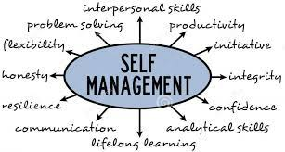
Negotiated Workplace Learning Week 9
Self Management
Sandra Okwara

Slide 2
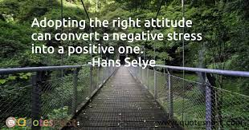
Achieving Excellence through self management
Understand how to adopt the right attitude in the work place
How to set goal to achieve excellence in the workplace.
Understand how to take responsibility for yourself

Slide 3
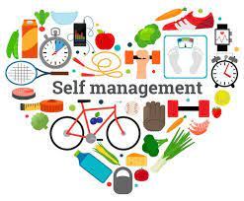
Meaning of Self management
Taking charge of your performance to enable success and advancement in the workplace.
Drucker (1999)wrote, "Only when you operate from strengths can you achieve true excellence." And to achieve excellence and be the best team member you can be, he said, you must develop a thorough understanding of who you are. You must identify your strengths and values, understand your weaknesses, and discover where you can make the biggest contribution to your organization.

Slide 4

Achieving Excellence through adopting the right attitude
Positive thinking
Developing Emotional Intelligence
Learning and Listening
Proactiveness
Negotiating for a win win Solution

Slide 5
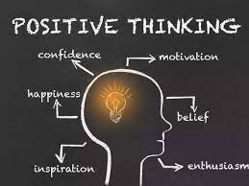
Using Positive thinking in the workplace
Having an optimistic attitude supports in problem solving when problem is encountered.
Thinking positively motivates individuals in achieving their focusing and the achievement of goals.
Reducing the amount of stress when the individual gets stressed helps ease tension and enables the individual to think clearly .

Slide 6
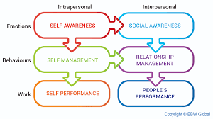
Developing Emotional Intelligence
It is important to understand the individuals you work with and use your strengths to create good working relationships
Having emotional Intelligence means individuals are able to understand their own feelings and the feeling of others.
Being empathetic, you can recognize and address the needs and wants of those around you.

Slide 7
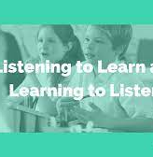
Listening and Learning from others
Willing to listen to, and learn from, your boss, your colleagues, and your team members is important in self management .
Make a conscious effort to focus on what those around you are saying. Practice Active Listening to show them that you value their thoughts, and to avoid being distracted.

Slide 8

Being Proactive
Look for ways to solve problems instead of waiting for things to happen
Share your ideas on how things can be improved in the workplace
Find opportunities to grow by developing and sharing your ideas proactively.

Slide 9
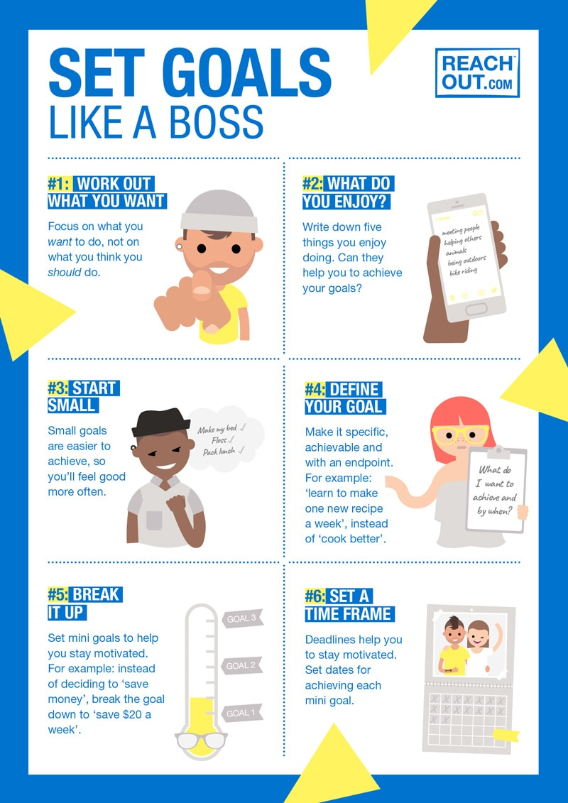
Setting your goals right
Use your Strength
To succeed in the workplace, it's important to identify your strengths and weaknesses, establish measurable goals, and choose an inspiring career objective.
Seek feedback from those around you.
Find opportunities to grow by developing and sharing your ideas proactively.
Identify your weakness and attend courses to improve your self

Slide 10
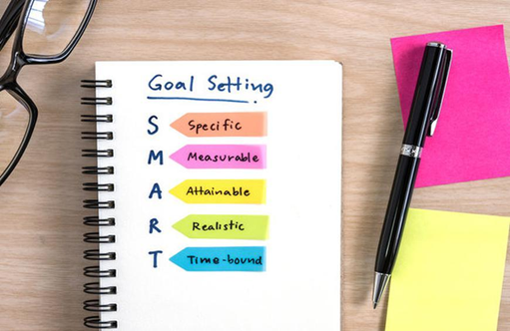
Setting your goals right
Set smart Goals
Specific
Measurable
Attainable
Relevant
Time-bound

Slide 11
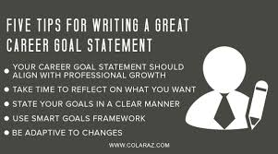
Prepare a Personal Career Statement
Have a career goal
Have a plan to achieve the goals
Create yourself a personal statement
Define your purpose
Measure your progress

Slide 12

Take Responsibility for yourself
Being organized, self-motivated and self-disciplined, you can find the time to hit your own targets, as well as the ones your manager sets for you.
Organize Your Workday. Some of us prefer to tackle our hardest tasks in the morning, when we are freshest. Others need a few hours to "get into their groove" and are most productive later in the day

Slide 13

Motivate yourself
Self-motivated people are confident and goal-oriented, and create a positive environment. The more motivated you are, the faster you'll achieve your goals, and the better you'll become at your job.
Simple self-motivation techniques include doing less enjoyable duties without procrastinating , and giving yourself rewards when you complete a task, such as a mealtime treat for a small task, or a spa day for a major one.

Slide 14
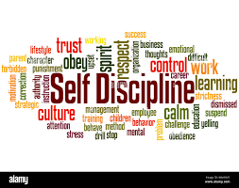
Self Discipline
People who have Self-Discipline keep striving towards their goals, regardless of how they feel, and despite distractions or challenges. If they encounter a roadblock, they figure out a way to get round it. If they have bad habits, they replace them with good ones .
For example, if you are always checking your emails, get into the habit of scheduling set times for reading and responding to them.

Slide 15

Remember
Manage yourself effectively, you'll be better able to reach your potential and pursue a fulfilling career
To manage yourself, it's important to adopt the right attitude. Remain optimistic, develop your emotional intelligence, reduce stress, be proactive, and learn from others
You'll also need to identify your strengths, and use them to set yourself the right goals.
Learn how to manage your time wisely. If you stay organized, remain motivated and exercise self-discipline, you'll be well on your way to becoming the successful, highly effective person you've always dreamed of being.

Slide 16
Review learning ?
What have we learnt
What changes will you make from now?

Slide 17


What have you Learnt?

